Slide 1
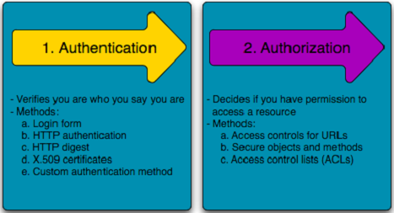
Chapter 3. Authentication & Access Control

Slide 2
Outline
Authentication
Access Control - overview
Access Control Terminology
Access Control models

Slide 3
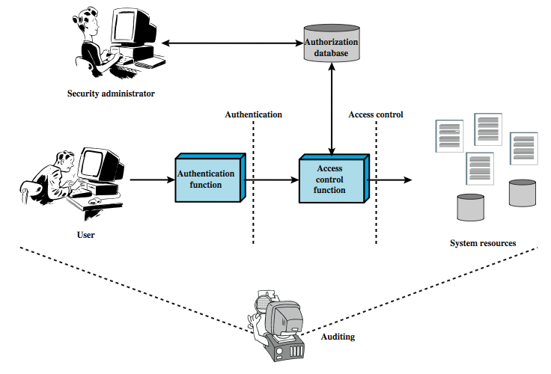

Slide 4
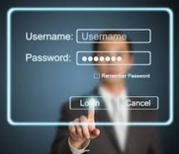
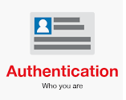
Authentication
Authentication is about validating your credentials such as Username/User ID and password to verify your identity.
Authentication factors determine the many different elements the system uses to verify one’s identity before granting the individual access to anything.

Slide 5
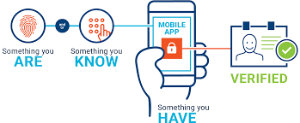
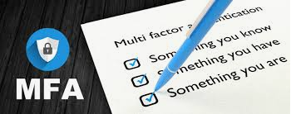
Authentication
Based on the security level, authentication factors can vary from one of the following:
Single- Factor Authentication
Two- Factor Authentication
Multi- Factor Authentication

Slide 6
Authentication
“Passwords are one of the biggest practical problems facing security engineers today.”
Something You Know
Passwords
Lots of things act as passwords!
PIN
Social security number
Date of birth
Name of your pet, etc.
Good and Bad Passwords
Other Password Issues
Too many passwords to remember
Attacks on Passwords
Social engineering
Techniques to attack passwords
Electronic monitoring
Access the password file
Brute force attacks
Directory attacks
Social engineering
Bugs, keystroke logging, spyware, etc.

Slide 7

Authentication
Something you are
Biometric - “You are your key”
Examples
Fingerprint
Handwritten signature
Facial recognition
Speech recognition
…

Slide 8
Authentication
Something you have
Examples include
Car key
Laptop computer
Or specific MAC address
Password generator
We’ll look at this next
ATM card, smartcard, etc

Slide 9
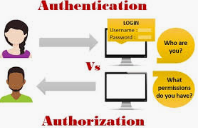
Access controls
Access control is the collection of mechanisms that permits managers of a system to exercise a directing or restraining influence over the behavior, use, and content of a system.
It permits management to specify what users can do, which resources they can access, and what operations they can perform on a system.

Slide 10
Access Control
Physical access control: fencing, hardware door locks,… that limit contact with devices
Technical access control: technology restrictions that limit users on computers from accessing data
Access controls encompass:
File permissions, such as the right to create, read, edit or delete a file.
Program permissions, such as the right to execute a program.
Data permissions, such as the right to retrieve or update information in a database.

Slide 11
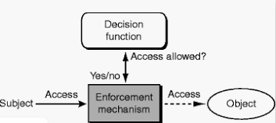
Access Control
Access controls: The security features that control how users and systems communicate and interact with one another.
Access: The flow of information between subject and object
Subject: An active entity that requests access to an object or the data in an object
Object: A passive entity that contains information
Security Principle: CIA

Slide 12
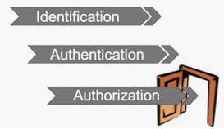
Access Control Terminology
Identification, authorization, and authorization are distinct functions.
Identification
Method of establishing the subject’s (user, program, process) identity.
Authentication
Method of proving the identity
Authorization
Determines that the proven identity has some set of characteristics associated with it that gives it the right to access the requested resources.

Slide 13
Identification
Method of establishing the subject’s (user, program, process) identity.
Use of user name or other public information
Know identification component requirements.
When using identification values to users, the following should be in place:
Each value should be unique, for user accountability;
A standard naming scheme should be followed;
The value should be non-descriptive of the user’s position or tasks

Slide 14

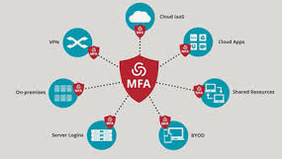
Authentication
Method of proving the identity
Something a person is, has, or does.
Use of biometrics, passwords, passphrase, token, or other private information.
Strong authentication is important
To be properly authenticated, the subject is usually required to provide a second piece to the credential set (i.e., password, passphrase, key, PIN, token etc(.

Slide 15

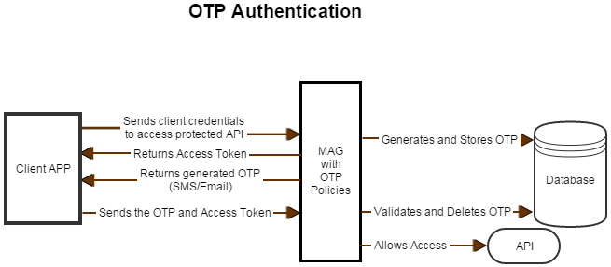
Authentication
One Time Passwords
Used for authentication purposes and are only good once
This type of system is not valuable to electronic eavesdropping, sniffing, or password guessing

Slide 16
Authentication
Single Sign-On (SSO)
SSO is a property of access control of multiple, related, but independent software systems. With this property a user logs in once and gains access to all systems without being prompted to log in again at each of them.
As different applications and resources support different authentication mechanisms, single sign-on has to internally translate to and store different credentials compared to what is used for initial authentication.

Slide 17
Authorization
Determines that the proven identity has some set of characteristics associated with it that gives it the right to acces the requested resources.
Grating access rights to subjects should be based on the level of trust a company has in a subject and the subject’s need to know.
Is a core component of every operating system and established whether a user is authorized to access a particular resource and what actions he is permitted to perform on the resource.

Slide 18
Authorization
Access criteria can be thought of as:
Roles:
Is an effective way to assign rights to a type of user who performs a certain task (job assignment or function).
Groups:
When several users require same type of access to information and resources
Location:
To restrict unauthorized individuals from being able to get in and reconfigure the server remotely
Time:
Restrict the times that certaun actions or services can be accessed
Transaction type:
Can be used to control what data is assesses during certain types of functions and what commends can be carried out on the data

Slide 19
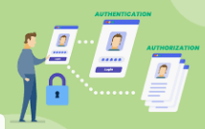

Authorization
Problems in controlling access to assess:
Different levels of users with different levels of access
Resources may be classified differently
Diverse identity of data
Corporate environments keep changing
Solutions that enterprise wide and single sign on solutions
User provisioning
Password synchronization and reset
Centralized auditing and reporting
Integrated workflow (increase in productivity)
Regulatory compliance

Slide 20
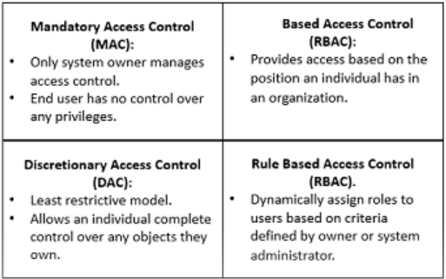
Access Control models
How does someone grant the right level of permission to an individual so that they can perform their duties? Access control models define how permissions are assigned.
Access control model – hardware and software predefined framework that custodian can use for controlling access
Access control models have four flavors:
Mandatory Access Control (MAC)
Role Based Access Control (RBAC)
Discretionary Access Control (DAC)
Rule Based Access Control (RBAC)
Attribute-based access control

Slide 21
Mandatory Access Control (MAC)
The Mandatory Access Control, or MAC, model gives only the owner and custodian management of the access controls.
This means the end user has no control over any settings that provide any privileges to anyone.

Slide 22
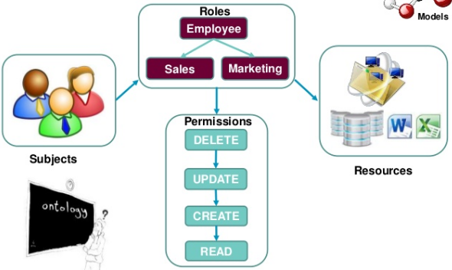
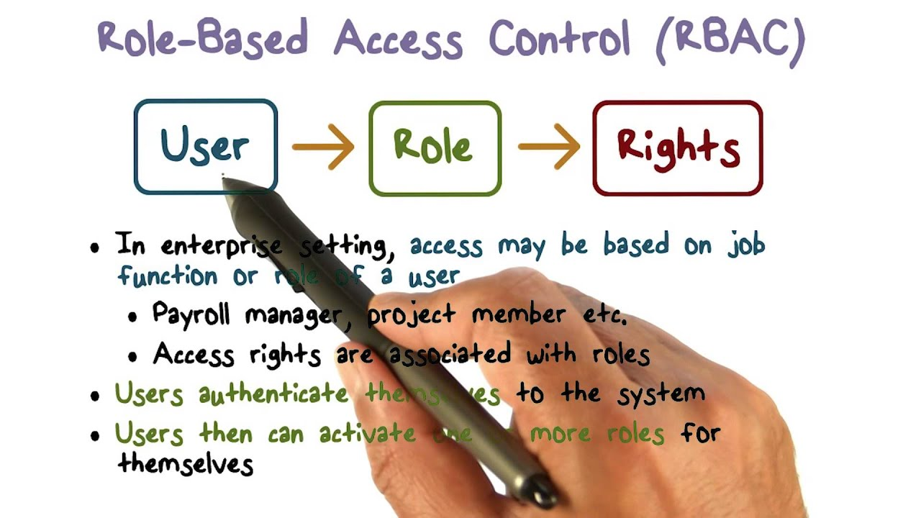
Role Based Access Control (RBAC)
Provides access control based on the position an individual fills in an organization.
Instead of assigning John permissions as a security manager, the position of security manager already has permissions assigned to it

Slide 23
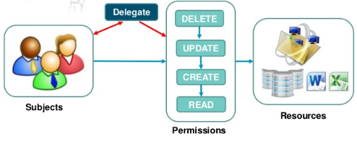
Discretionary Access Control
The Discretionary Access Control, or DAC, model is the least restrictive model compared to the most restrictive MAC model.
DAC allows an individual complete control over any objects they own along with the programs associated with those objects.

Slide 24
Rule Based Access Control
Rule Based Access Control will dynamically assign roles to users based on criteria defined by the custodian or system administrator.
For example, if someone is only allowed access to files during certain hours of the day, Rule Based Access Control would be the tool of choice.

Slide 25
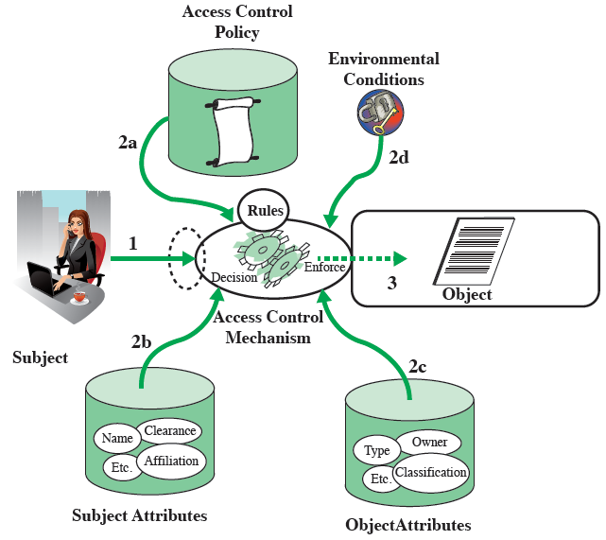
Attribute-based Access Control (ABAC)
Define authorizations that express conditions on properties of both the resource and the subject
Types of attributes
Subject attributes: Name, Organization, Job title
Object attributes: Title, Author, Date
Environment attributes: Describe the operational, technical, and even situational environment or context in which the information access occurs: Current date, Network security level, Current virus/hacker activities

Slide 26
Implementing Access Control
Access Control List:
Set of permissions attached to an object
Group policy
MS Windows feature that provides centralized management and configuration of computers and remote users using Active Directory
Account restrictions
Time of day restrictions: limits the time of day a user may log onto a system
Account expiration restrictions: process of setting a user’s account to expire

Slide 27
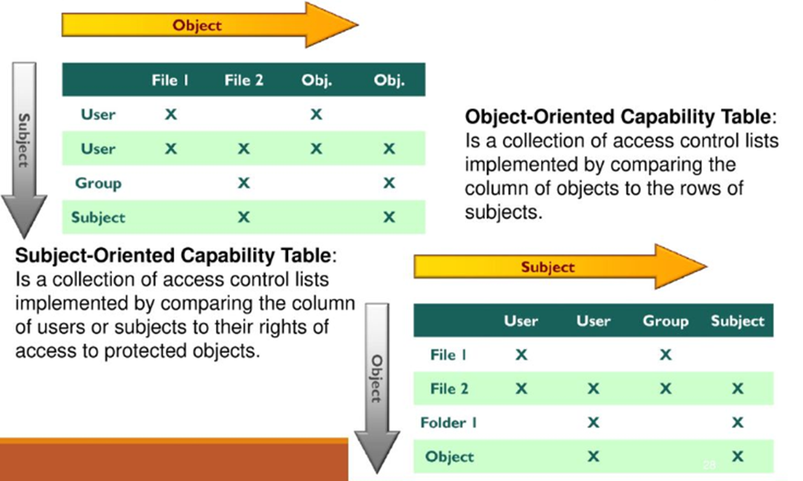
Access Control Techniques
Access Control Matrix
Is a table of subjects and objects indicating what actions individual subjects can take upon individual objects
Two types:
Capability table (bound to a subject)
Access control List (bound to an object)

Slide 28
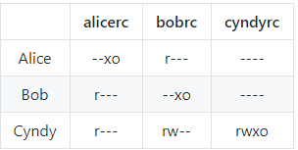
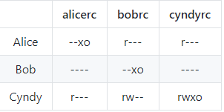
Ex1: Consider a computer system with three users: Alice, Bob, and Cyndy. Alice owns the file alicerc, and Bob and Cyndy can read it. Cyndy can read and write the file bobrc, which Bob owns, but Alice can only read it. Only Cyndy can read and write the file cyndyrc, which she owns. Assume that the owner of each of these files can execute it.
a. Create the corresponding access control matrix.
b. Cyndy gives Alice permission to read cyndyrc, and Alice removes Bob’s ability to read alicerc. Show the new access control matrix.

Slide 29
Ex2: Alice can read and write to the file x, can read the file y, and can execute the file z. Bob can read x, can read and write to y, and cannot access z
Write a set of access control lists for this situation. Which list is associated with which file?
Write a set of capability lists for this situation. With what is each list associated?
Set of access control lists. They are object focused so each list is associated with a file.
ACL(FileX) = Alice: {read, write}, Bob: {read}
ACL(FileY) = Alice: {read}, Bob: {read, write}
ACL(FileZ) = Alice: {execute}, Bob: {}
Set of capability lists. They are subject focused, so each list is associated with a user.
CList(Alice) = FileX: {read, write}, FileY: {read}, FileZ: {execute}
CList(Bob) = FileX: {read}, FileY: {read, write}, FileZ: {}

Slide 30
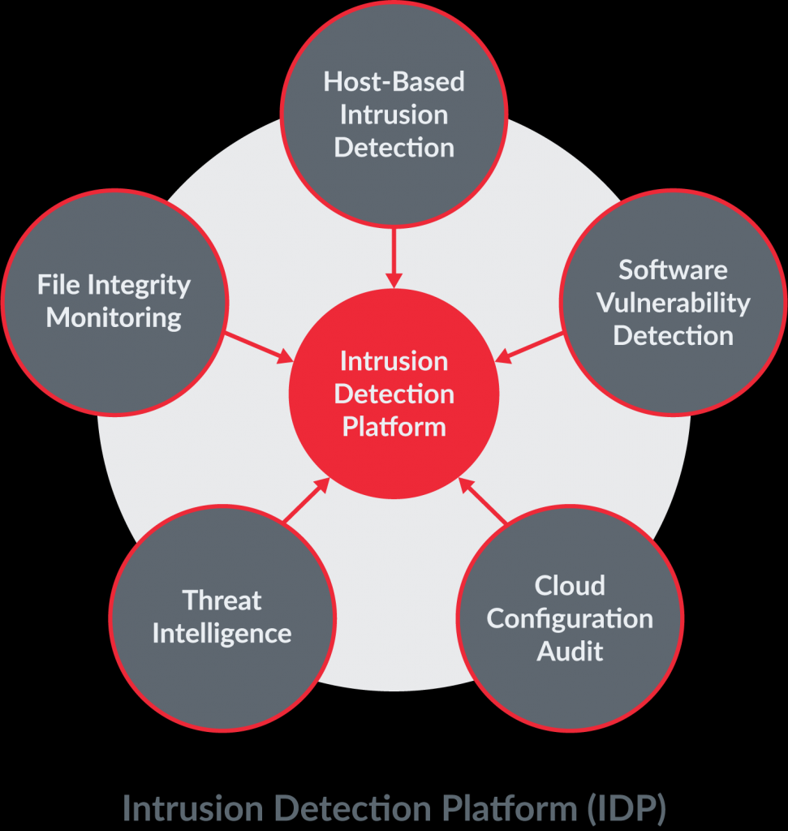
Access Control Monitoring
Intrusion detection
Three common components
Sensors
Analyzers
Administrator Interfaces
Common types
Intrusion detection
Intrusion prevention
Honeypots
Network sniffers

Slide 31
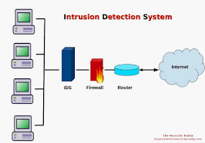
Access Control Monitoring
Two main types of Intrusion Detection Systems
Network Based (NIDS)
Host Based (HIDS)
HIDS & NIDS can be
Signature Based
Statistical Anomaly Based
Protocol anomaly based
Traffic anomaly based
Rule Based

Slide 32
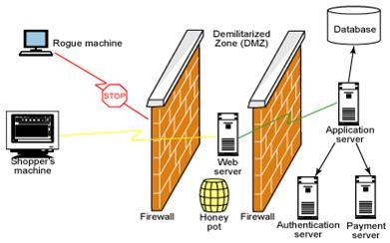
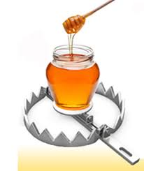
Access Control Monitoring
Intrusion Prevention System
Is a preventive and proactive technology, IDS is a detectve technology
Two types: Network Based (NIPS) and Host Based (HIPS)
Honeypots
An attractive offering that hopes to lure attackers away from critical systems
Network sniffers
A general term for programs or devices that are able to examine traffic on a LAN segment.

